Slide 1


Germany
The competitveness of the Industries of the future
Presentation by:
Volker Friedrich
Managing Partner
GBP INTERNATIONAL
Potsdam, 27th February 2024

Slide 2

1. Short Intro
2. Why was Germany so strong in the past?
3. Where are we today?
4. What are the needs for the future?
5. New competition from Asia
6. Light at the end of the tunnel?
Outlook & Discussion
Agenda
"Dieses Foto" von Unbekannter Autor ist lizenziert gemäß CC BY-SA
"Dieses Foto" von Unbekannter Autor ist lizenziert gemäß CC BY-SA

Slide 3

When and why is a country competitive – who is leading in 2023?
"Dieses Foto" von Unbekannter Autor ist lizenziert gemäß CC BY-SA

Slide 4
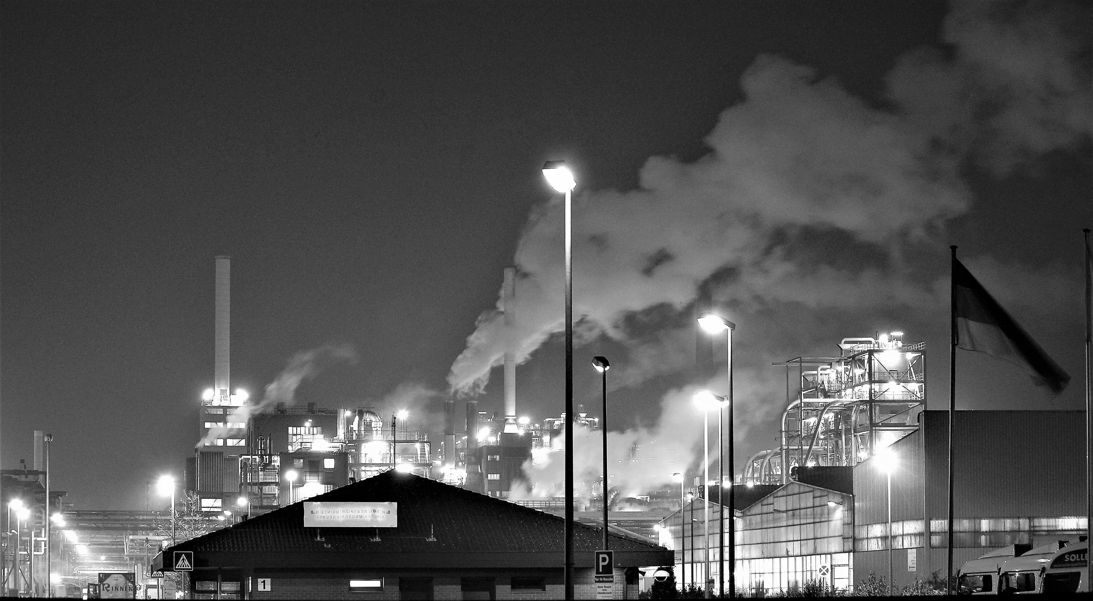
What were the foundations of Germany´s successful economy in the last century?
"Dieses Foto" von Unbekannter Autor ist lizenziert gemäß CC BY-NC-ND
"Dieses Foto" von Unbekannter Autor ist lizenziert gemäß CC BY-SA-NC

Slide 5

What are the foundations of Germany´s successful today?
"Dieses Foto" von Unbekannter Autor ist lizenziert gemäß CC BY-SA-NC

Slide 6

Success Factors of the german industry
Industry Strength
High Export Quota
Open Economy
Medium-Sized Enterprises
Trade Fair Location
Diverse Economic Centers
Strong Educational System
High Degree of R&D and Innovations

Slide 7

GBP INTERNATIONAL
Management Consulting services
Is the Economy strong enough to withstand present Technological changes and new competitors?

Slide 8

Which Technologies and which skills are critical for future success?

Slide 9

Whichtechnologies are “Mission critical”?
Artificial Intelligence (AI) and Machine Learning (ML) - Internet of Things (IoT) & 5G Technology - Blockchain & Cybersecurity - Augmented Reality (AR) and Virtual Reality (VR) - Healthcare, Biotechnology and Genomics - Renewable Energy Technologies and sustainability solutions - Quantum Computing - Mobility Solutions - SPACE Technologies - Maritime Technologies
"Dieses Foto" von Unbekannter Autor ist lizenziert gemäß CC BY-SA

Slide 10

Which SKILLs are “Mission critical”?
Proficiency in analyzing and interpreting data
Skills in languages such as Python, Java, and others are valuable across various industries, especially for software development and automation
Understanding and applying AI and ML concepts
The ability to navigate and leverage digital tools and platforms
With the rise in cyber threats, skills to protect digital assets and information are in high demand
The ability to quickly adapt to new technologies and continuously learn
Effective communication, both written and verbal, is essential
The capability to analyze situations, think critically, and solve complex problems is highly valued
The ability to think creatively and contribute to innovative solutions
"Dieses Foto" von Unbekannter Autor ist lizenziert gemäß CC BY-SA

Slide 11

Why is competition from Asia a threat to the German Industry?
.
"Dieses Foto" von Unbekannter Autor ist lizenziert gemäß CC BY-NC-ND

Slide 12

Beware of the Tigers and Dragons
Cost Competitiveness Scale of Production
Technological Advancements
Global Value Chains
Government Support and Industrial Policies
Adaptation to Market Trends
Global Market Shares
Trade Dynamics

Slide 13

A critical view on the state of the German economy from the leading economists

Slide 14

Germany continuous to be competitive based on strong foundations
ABO Wind is a German renewable energy company that specializes in developing solar and wind projects
EnviTec Biogas, based in Germany, focuses on biogas production and is a market leader in Europe with a 25% market share in biomethane
CropEnergies is a German company specializing in biofuels production, including high-quality biodiesel and vegetable oil from certified sustainable resources
Solytic is a German company that provides monitoring and optimization solutions for solar energy systems, contributing to increased efficiency and performance in the renewable energy sector
Sunfire, a German company, focuses on producing clean hydrogen through innovative technologies, contributing to CO2 reduction efforts and sustainable energy production

Slide 15

please contact me
GBP INTERNATIONAL is a management consulting firm which was founded in 1997 by Volker Friedrich who is the major shareholder and managing partner of the company.
The company is registered in Malaysia as a private limited company.
The business of GBP INTERNATIONAL is spread along the complete supply chain of international operations, across countries and across most industry and technology segments.
Traditionally GBP INTERNATIONAL assists companies from Europe and USA to start, manage and optimise their operations in Asia-Pacific – from start ups to SME, and international conglomerates. We are proud to have Forbes 500 companies as our clients as well as unknow startups who may become the next Unicorn. Companies from Asia investing in Europa and USA are our customers as well.
Volker Friedrich
Email: vf@gbp-international.com
Mobile: +49-172-2154944
"Dieses Foto" von Unbekannter Autor ist lizenziert gemäß CC BY-NC

